Slide 1

Raffaele Cicellini
Francesca Forbicini

Slide 2
Introduction
The main objective of this mobile app is to make music-addicted test their knowledge about their favourite artists and playlists. They can also see how far other users of the app went with their quizzes.

Slide 3
Introduction
A user can make a quiz on his/her favourite artists or playlist.
Quizzes are infinite → they end if a user fails an answer or after a certain amount of questions, the user can choose to continue with another level or to stop to play.
A user can choose to see her/his best score, her/his position in a global rank (made all over the world) or in a local rank (based on the country of the user)
When the user saves her/his best score, he/she must take a picture and save the position.

Slide 4
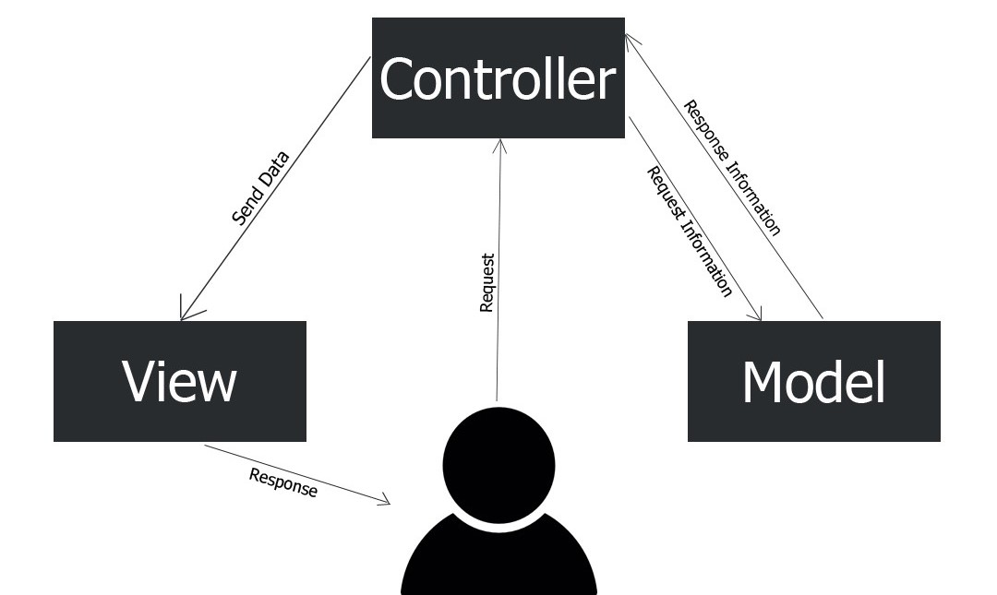
Architecture
Architecture

Slide 5
Architecture
We implement a MVC architecture, where
Model: classes without any logic related to the quiz or to spotify
Controller: communicates with Spotify API to retrieve the artists and playlists of a user and implements the logic of the quiz
View: widget to show quizzes, home screen, user profile and the authentication screen

Slide 6
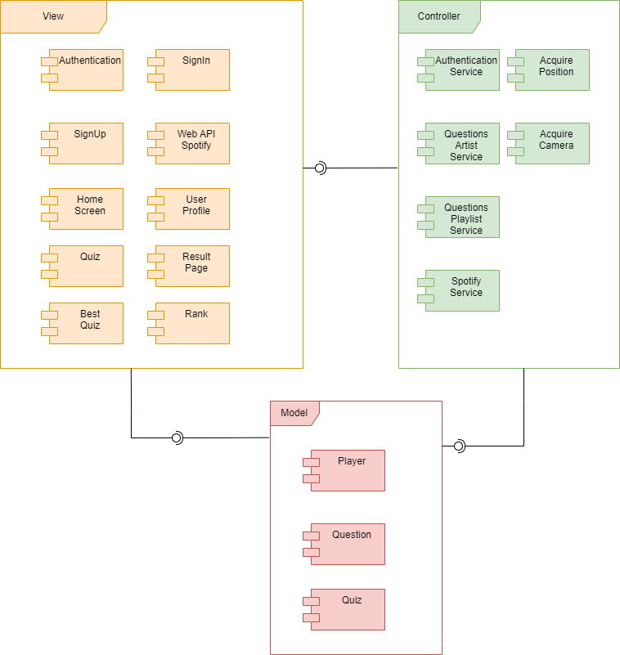

Slide 7
Technologies
Flutter to implement the mobile application
Firebase to store/retrieve data into/from the database
Spotify API to retrieve user’s playlist and favourite artist
Geolocator to retrieve user’s position
ImagePicker to allow the user to take a picture
Intl library to translate the application in Italian or in English it depends on the system language of the device of the user

Slide 8
Testing
We have implemented 12 integration tests with the 80% of coverage.
Authentication Test
sign-in test
sign-up test
sign-out test
sign-in error test
sign-up error test
Quiz Test
quiz of playlist test
quiz of artist test
Result Test
best result test
quiz finished test
User Profile Test
best quiz test
rank test
back to home test

Slide 9


